Slide 1
Control systems (UE21EC241b) PROJECT Roll angle control
PROFESSOR: TIPPESWAMY.E
AKASH RAVI BHAT(PES1UG21EC025)
ABHISHEK A SHETTY(PES1UG21EC008)
AKASH C K(PES1UG21EC022)
SECTION: A

Slide 2
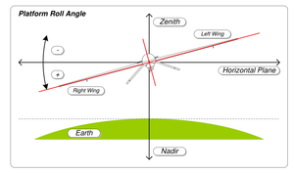
Introduction
Roll angle control (RAC) is required for the lateral stability of an aircraft. Lateral stability makes the aircraft more stable around the longitudinal axis.
Roll angle control makes both the wings of the aircraft to be at the same level.
If one of the wing dips below the other, then RAC tries to stabilize the system again

Slide 3
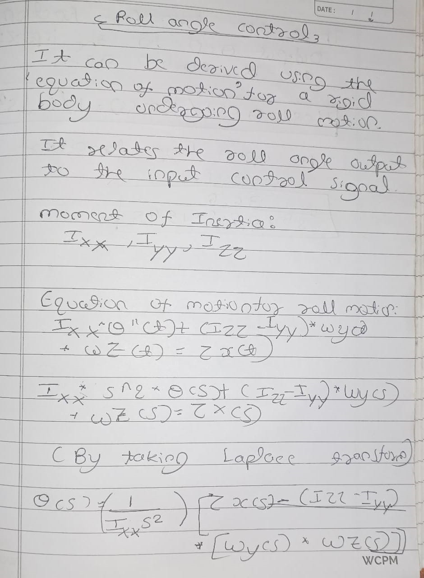

Slide 4
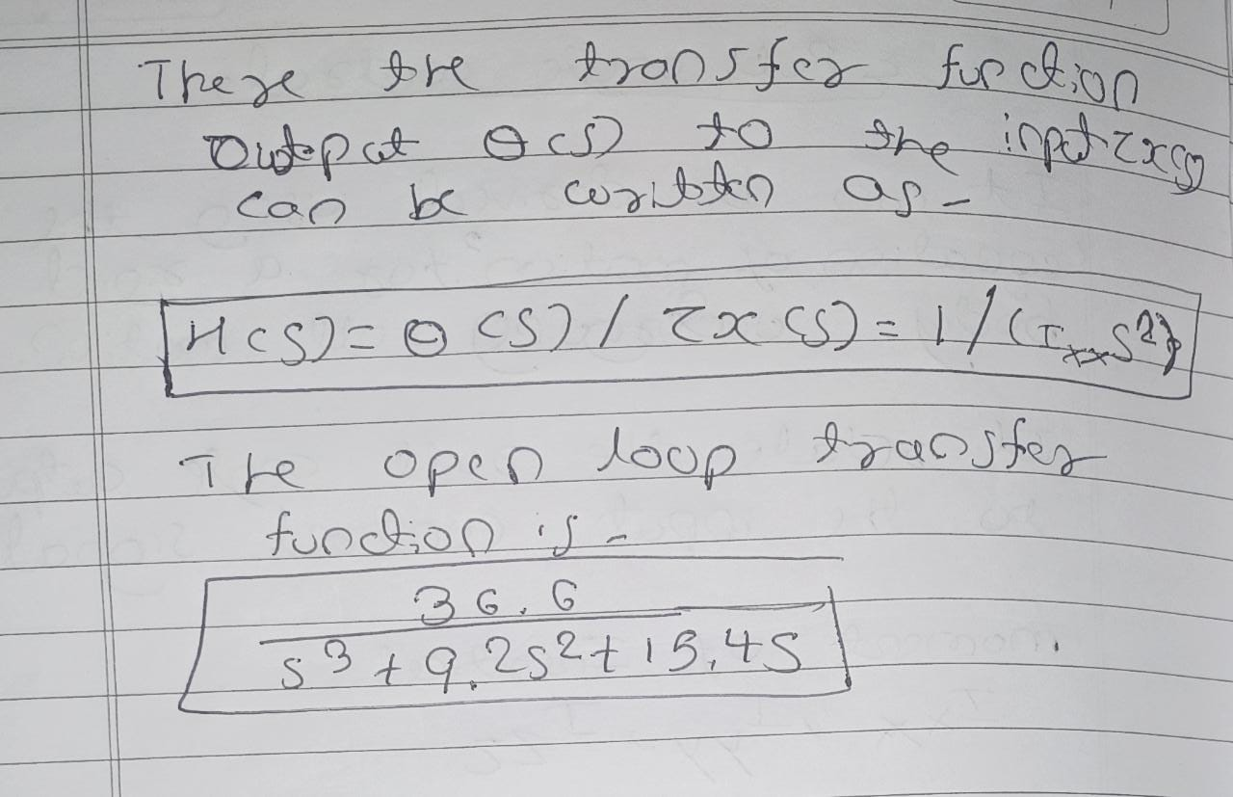

Slide 5
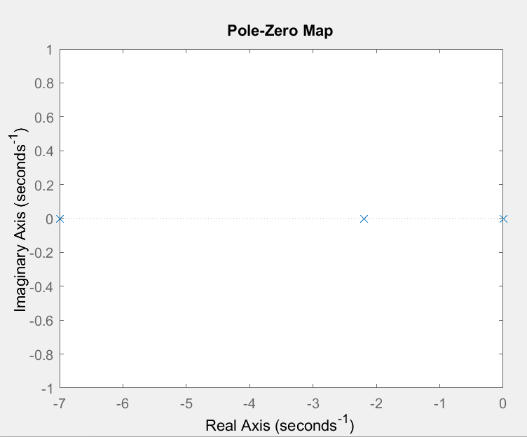
Q1
The open loop transfer function is
36.6
----------------------------
s^3 + 9.2 s^2 + 15.4 s
We first find the pole zero map first and it can be observed that the system is open loop stable
Poles are present at 0,-2,-7
We apply different test signals and observe that the system is stable only for impulse input and unstable for step and ramp input
Pole Zero Map

Slide 6
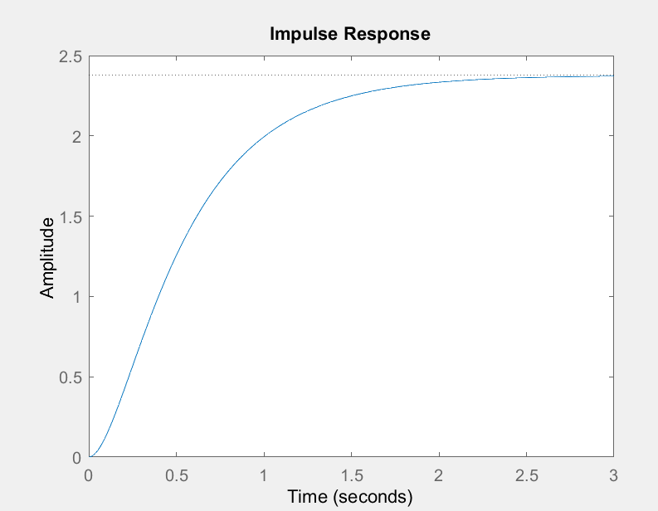
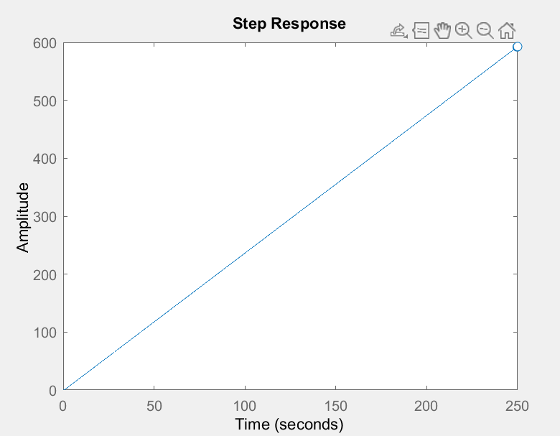
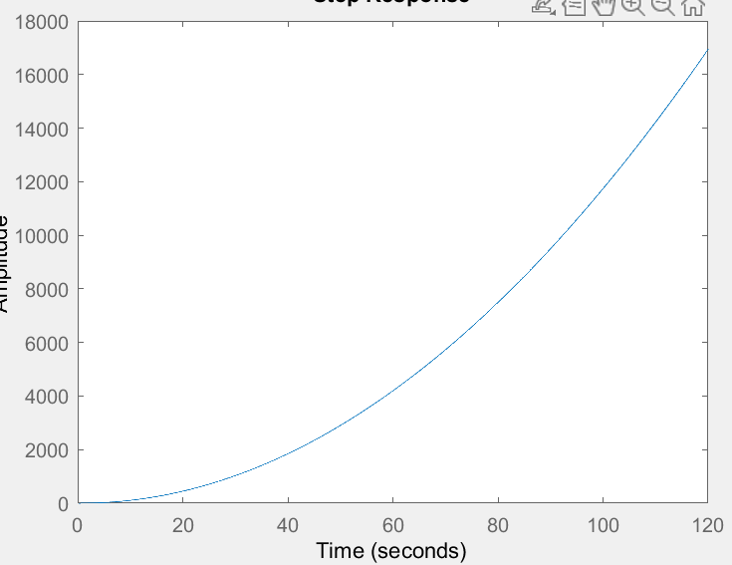
From the ramp response we can observe that the response is continuously increasing and unstable
From the impulse response we can observe that the response settles to a value and hence we can call it stable
From the step response we can observe that the response is continuously increasing and unstable

Slide 7
Q2
We apply a gain K in cascade with our initial transfer function
The theoretical method is using the RH criterion, where we use the RH table to determine the value of K.
Using this method we find that the for K < 3.87 the system is stable
To confirm this we use the pole zero plots
We apply different integer value of K in cascade with our transfer function
The poles lie on LHP for K<=3
The system becomes unstable when we take K = 4

Slide 8
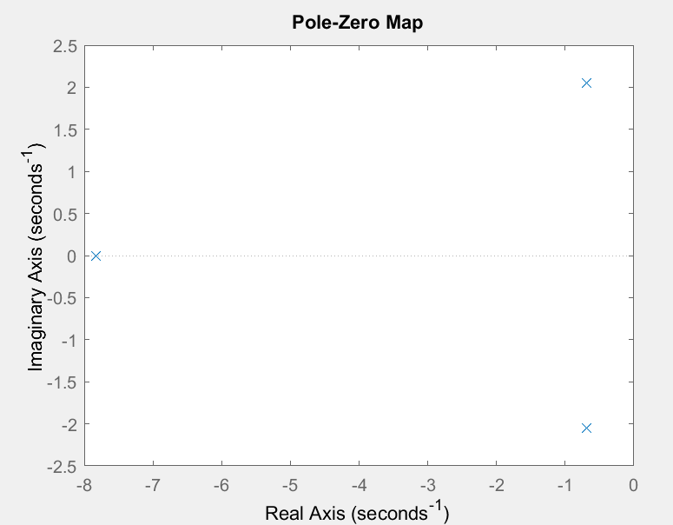
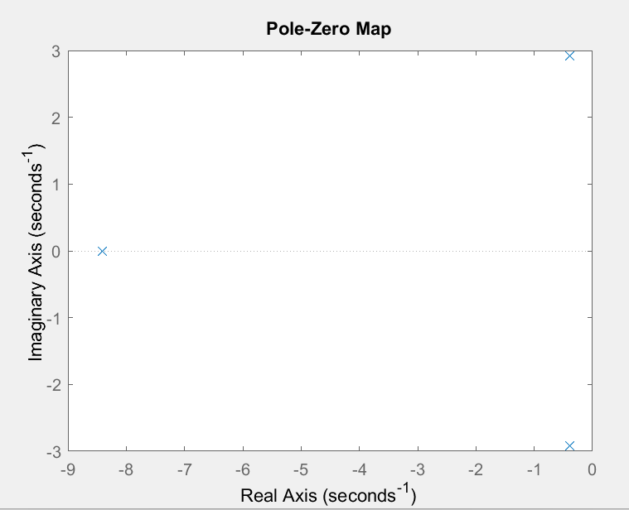
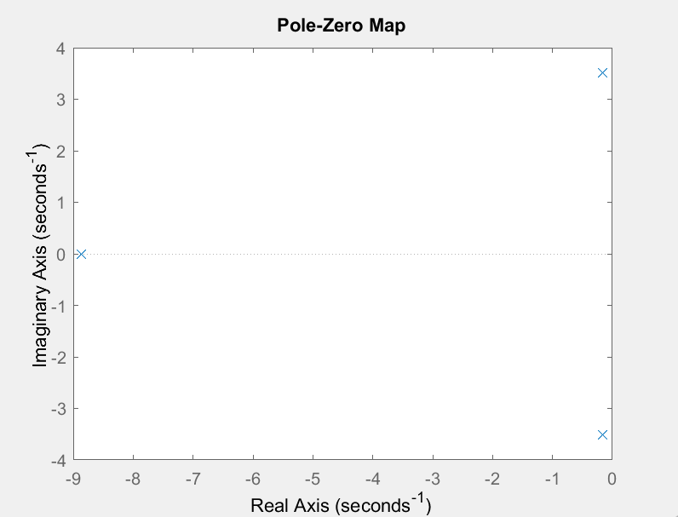
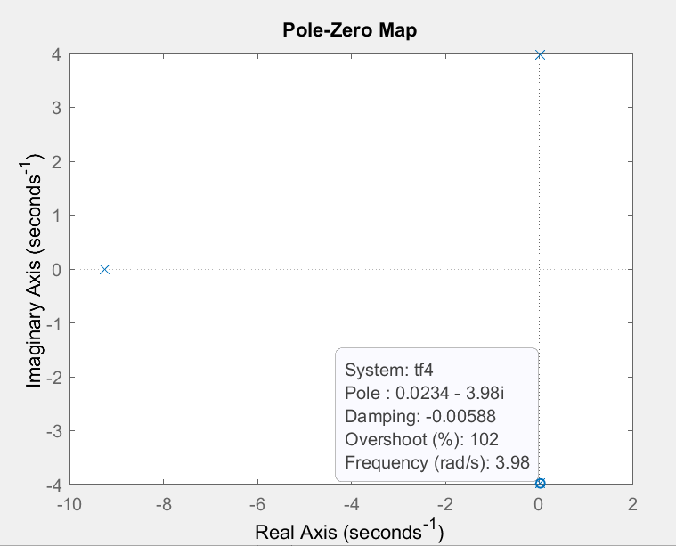
K = 1
K = 2
K = 3
K = 4

Slide 9
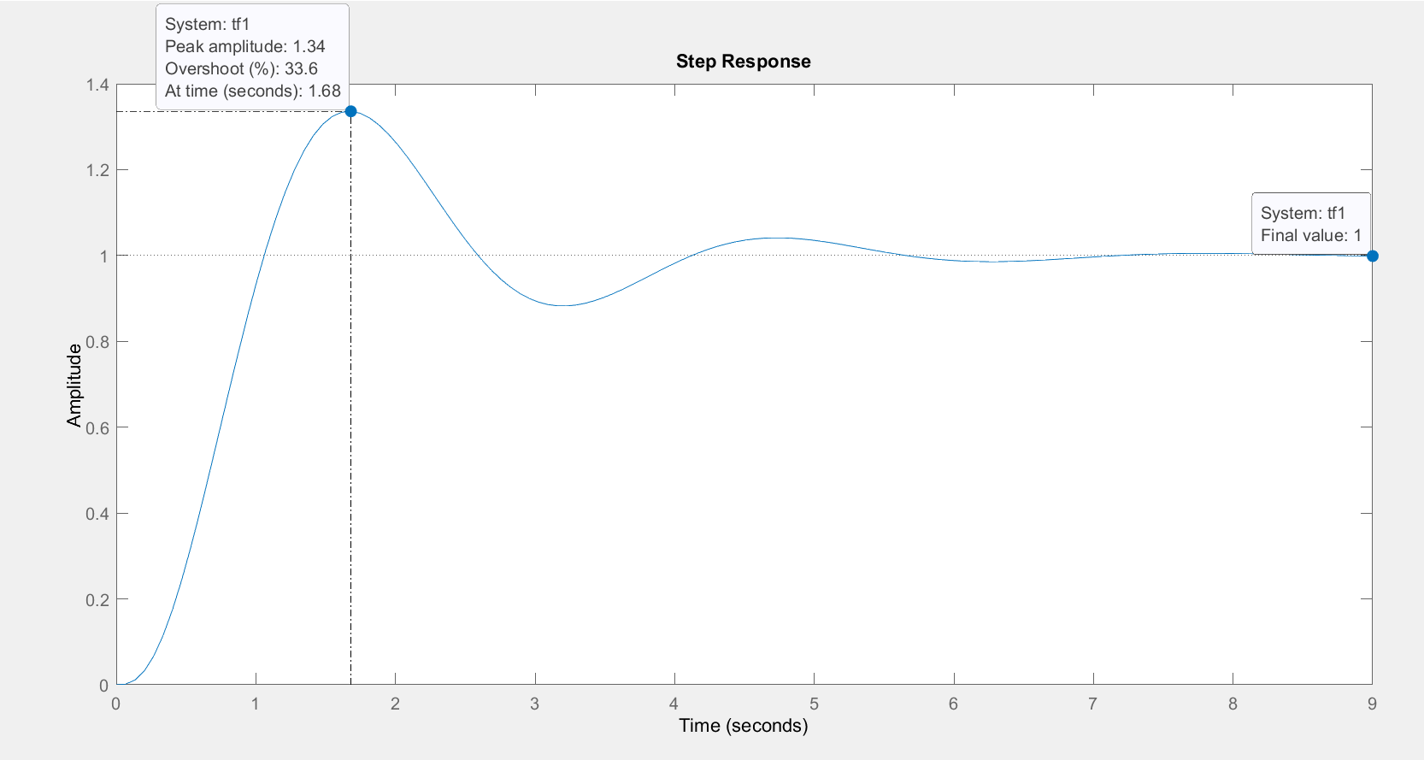
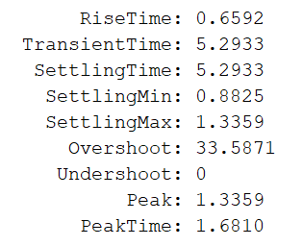
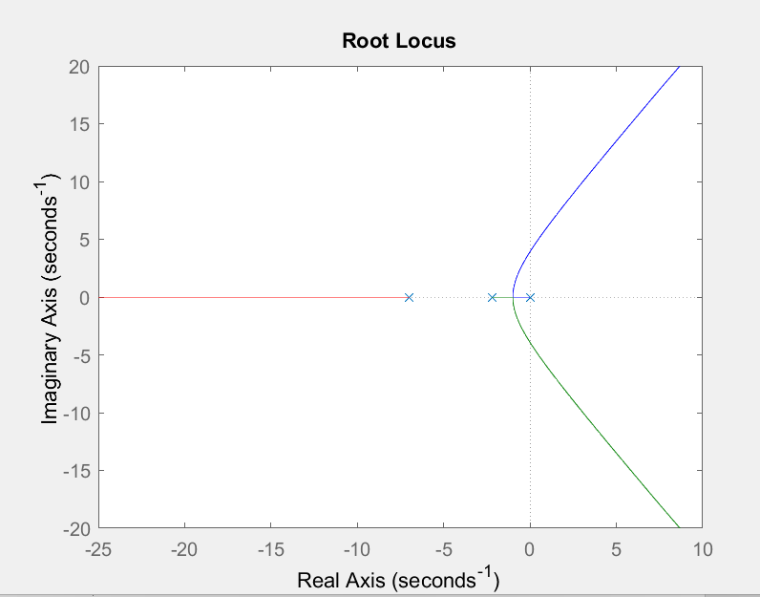
Q3
For the proportional controller we can take different values of K
For k = 1,we obtain the following characteristics

Slide 10
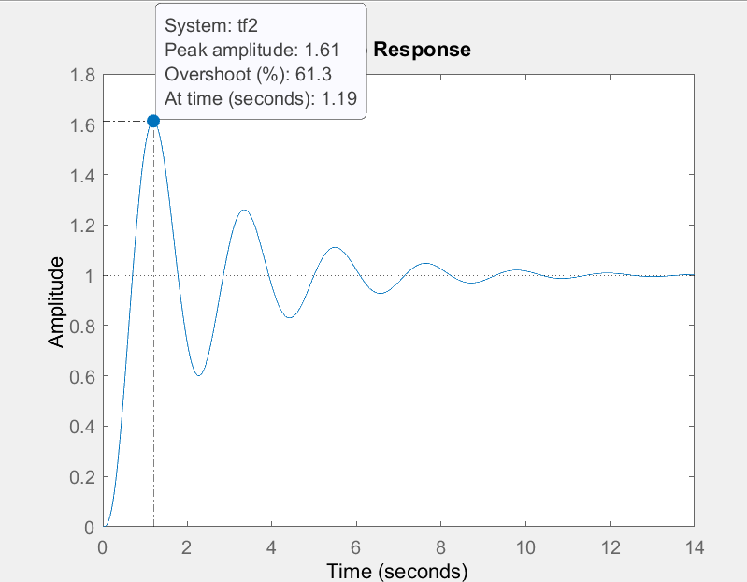
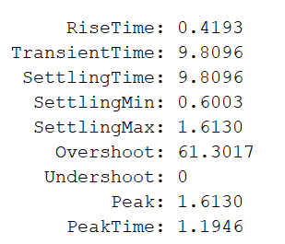
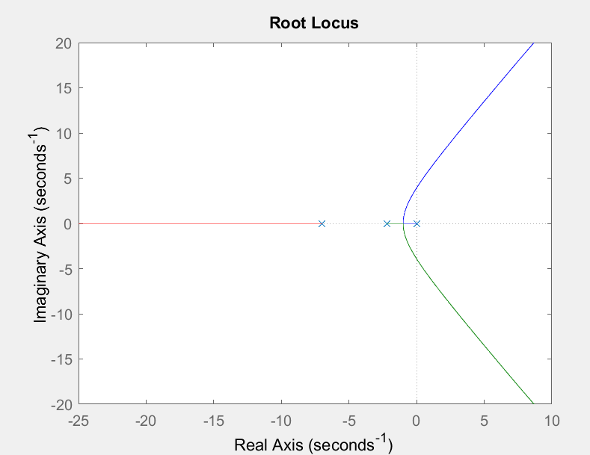
For K = 2

Slide 11
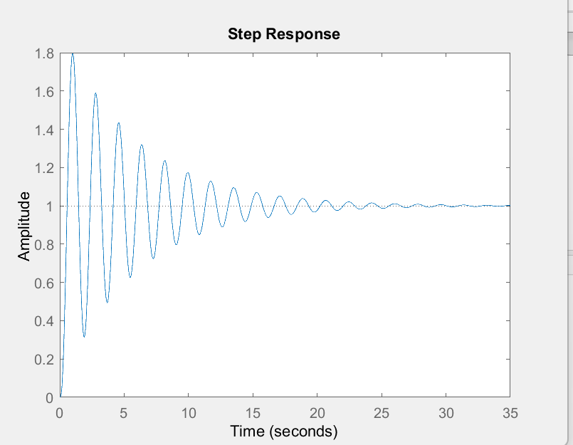
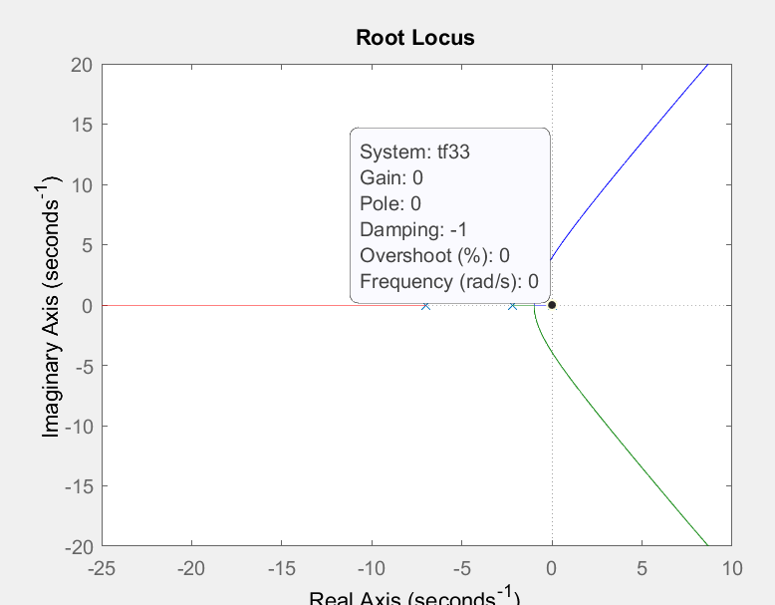
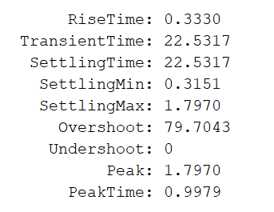
For K = 3

Slide 12
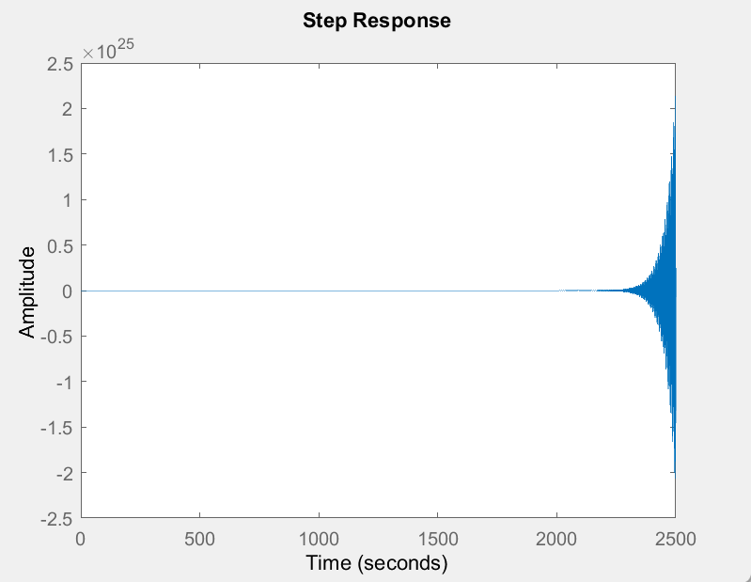
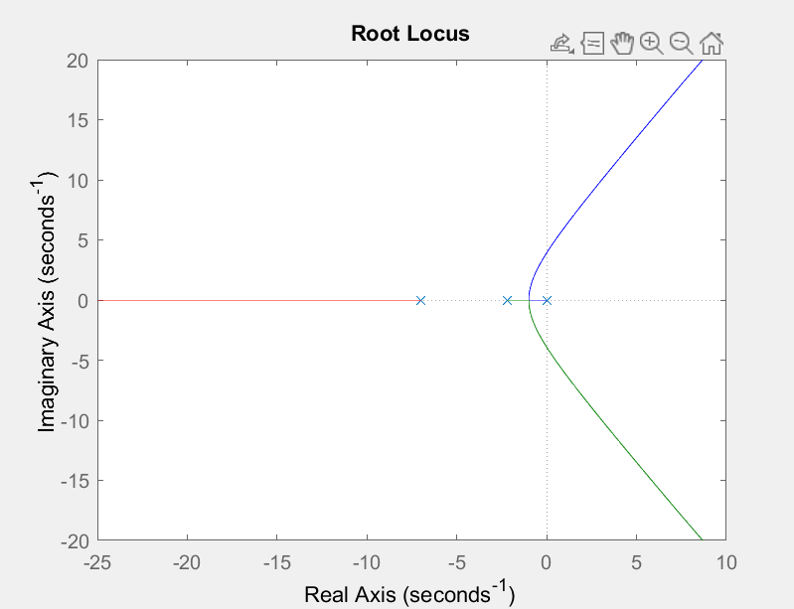
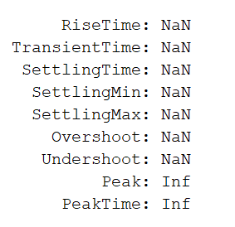
K = 4
We observe that for K = 4, the system becomes unstable which is evident from observing the step response graph
We also observe that the rise time is least for K = 3 and hence it’s the most suitable proportional controller for our system

Slide 13
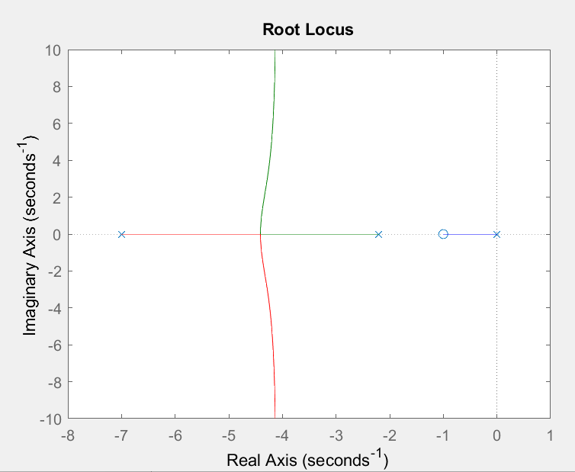
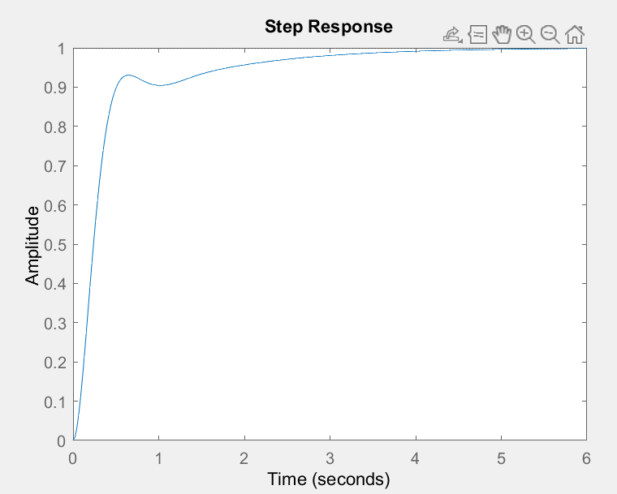
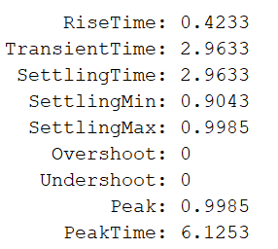
Q4
We introduce a new PD controller into the system by cascading K(s+z) with our system. We choose different values of K and z and obtain the step response for each and determine which is more suitable for our system
K = 1 and z = 1

Slide 14
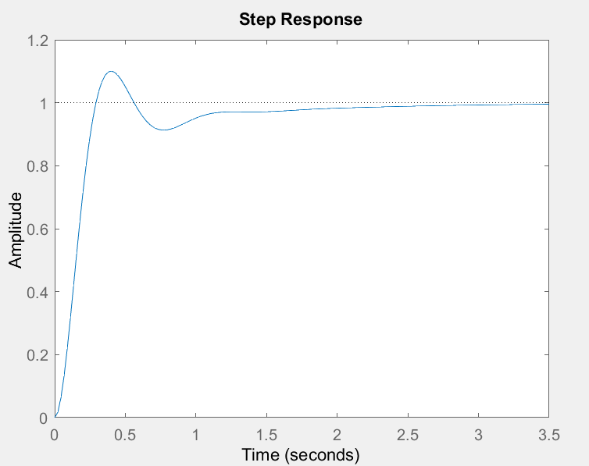
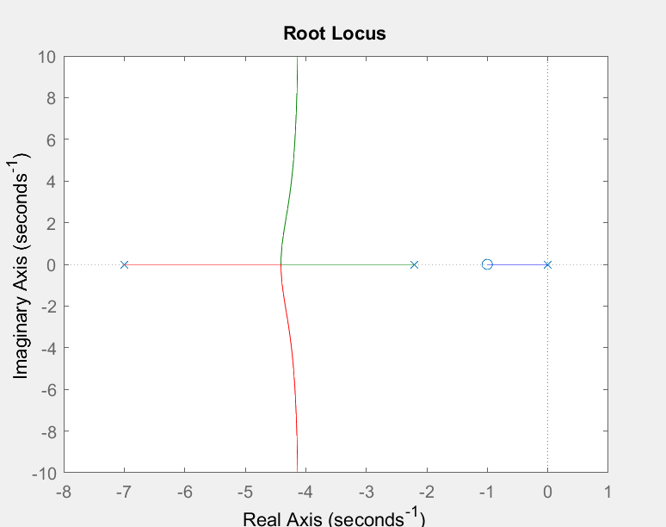
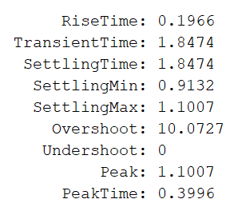
K = 2, z = 1

Slide 15
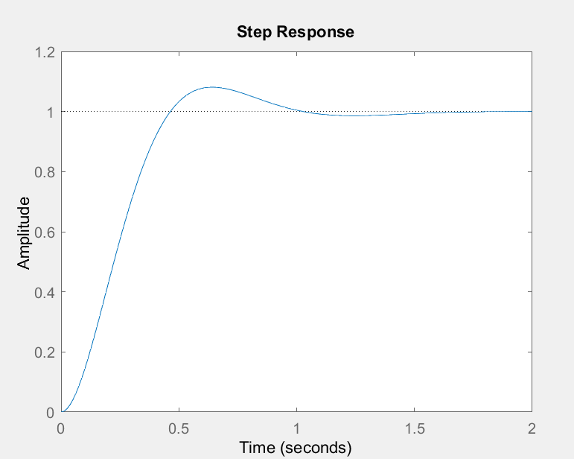
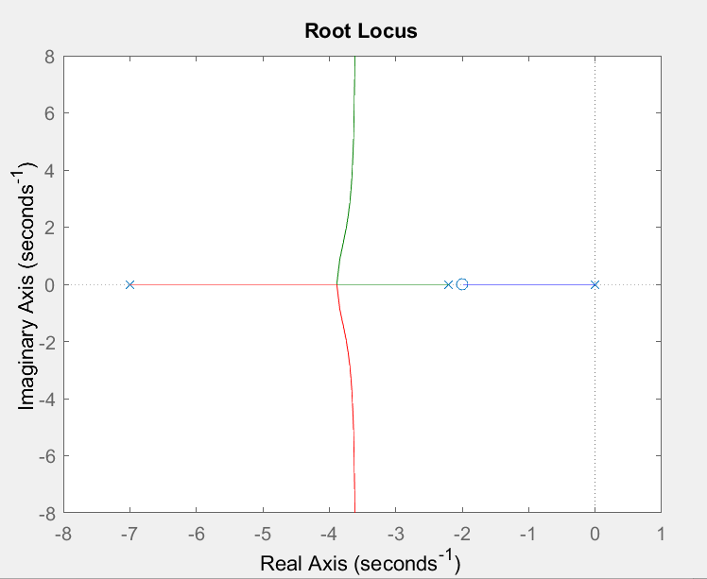
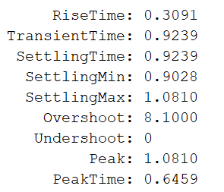
K = 1, z = 2

Slide 16
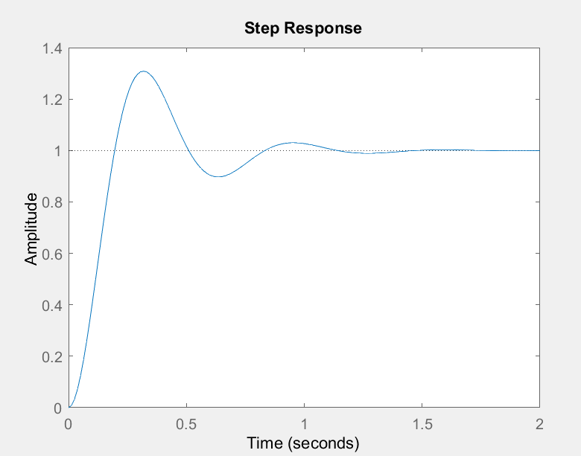
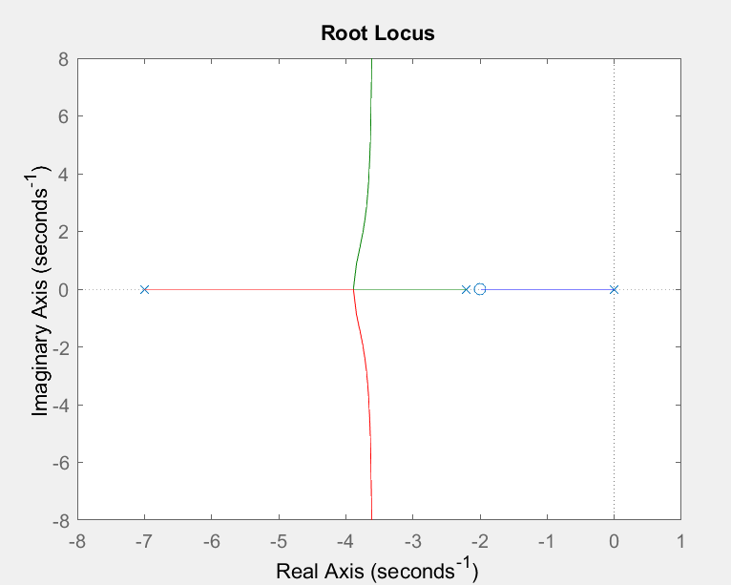
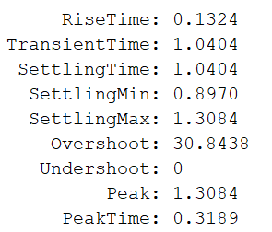
K = 3, z = 2

Slide 17
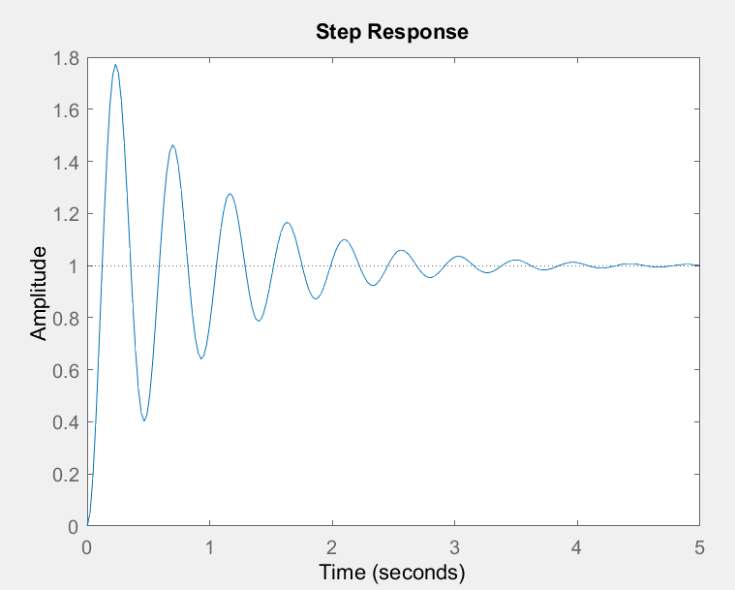
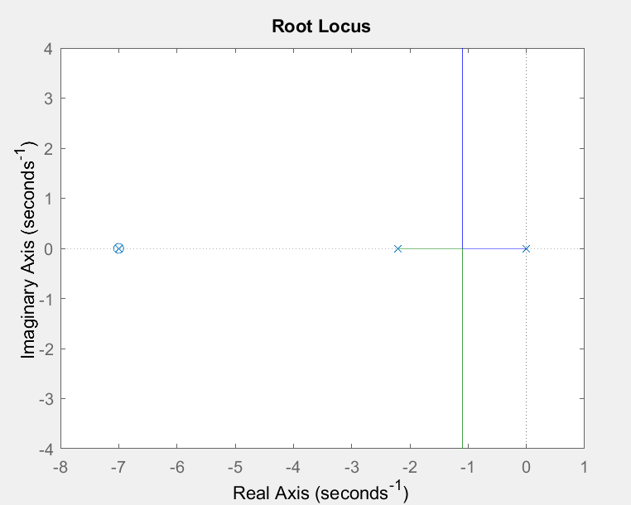
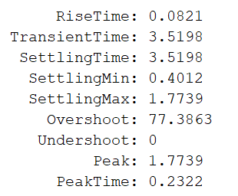
K = 5, z = 7

Slide 18
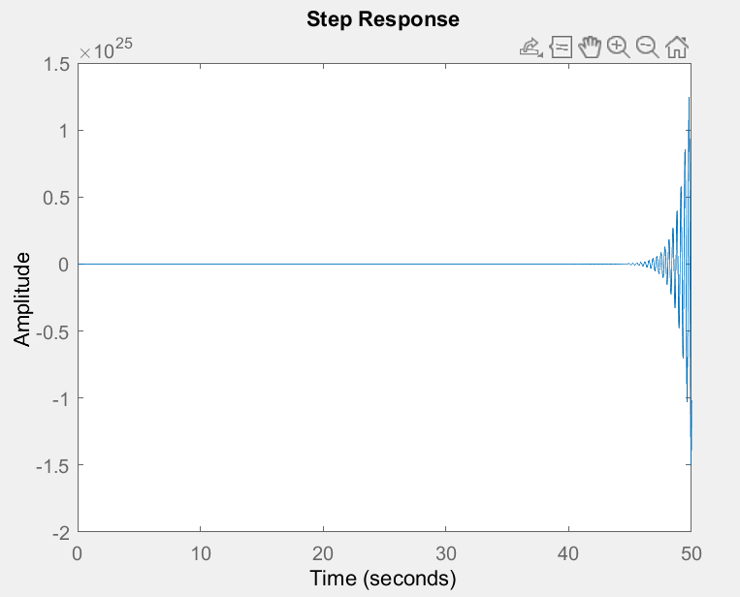
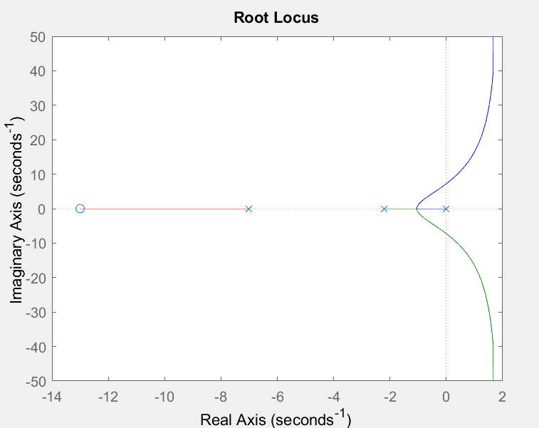
K = 9, z = 13

Slide 19
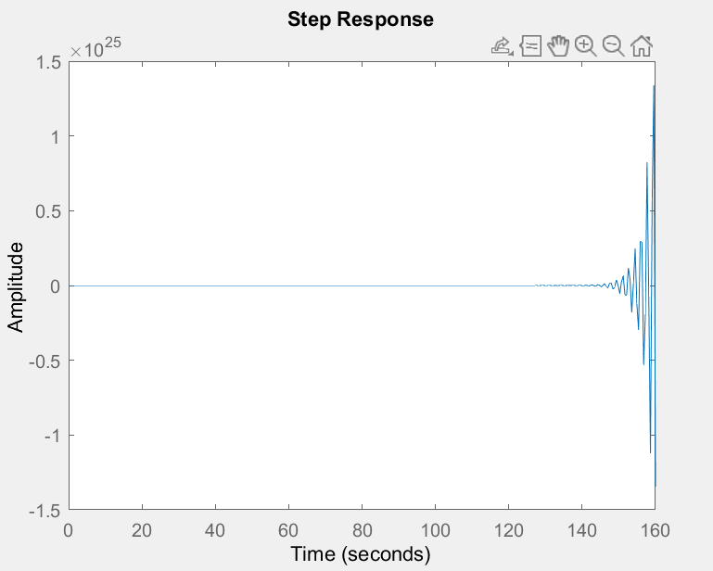
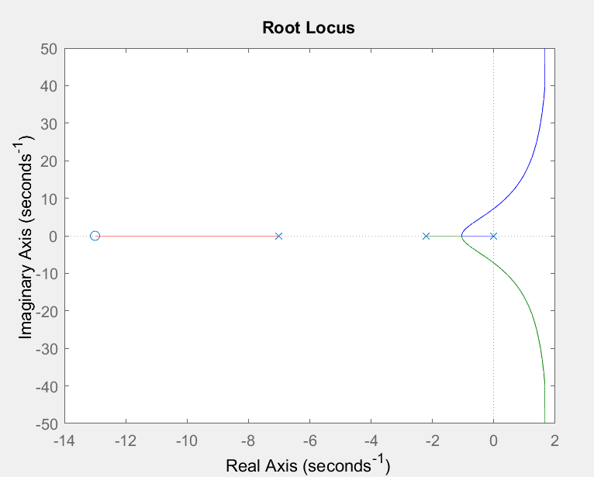
K = 2, z = 13
We observe that the introduction of zero allows for the system to have lower rise time for the same value of K. It makes the system more stable and allows higher values of K to be chosen, but there is a limit to this too. As we have observed from our examples, if the value of K is too high(in our example K = 9) the system tends to be unstable. Even in the case of the zero being non dominating, i.e, far away from the origin, the system ends up being unstable(as seen in our example z = 13)
The best combination in our examples was found to be K = 5, z = 7

Slide 20
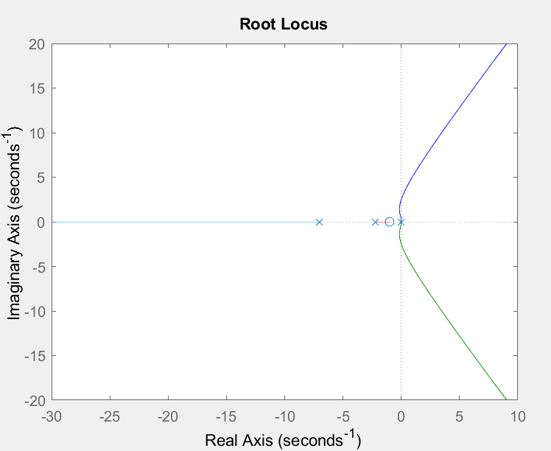
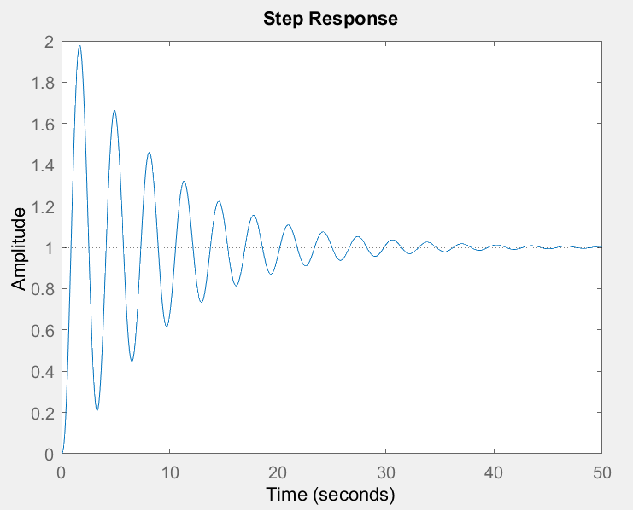
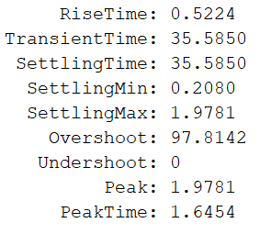
Q5
Adding a pole to our system is equivalent to have an integral controller
We introduce [K(s+z)/z] to our system to have a PI controller
For k = 1, z = 1

Slide 21
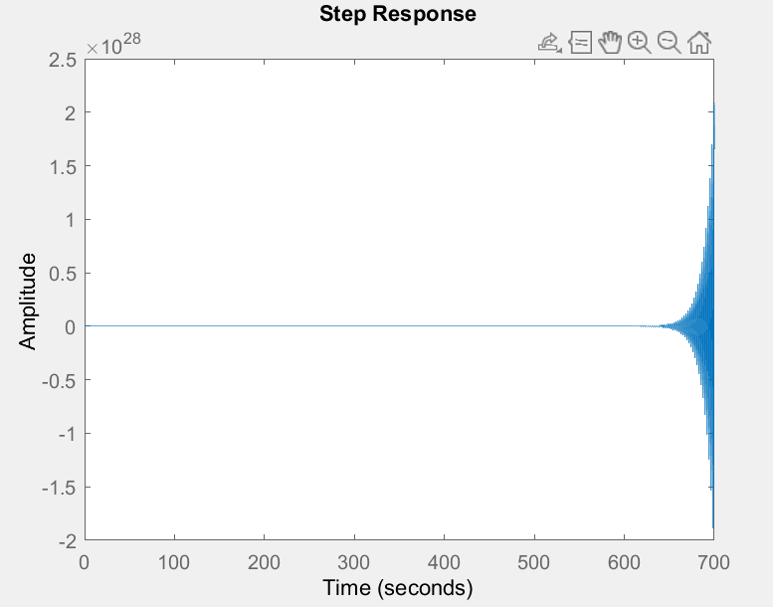
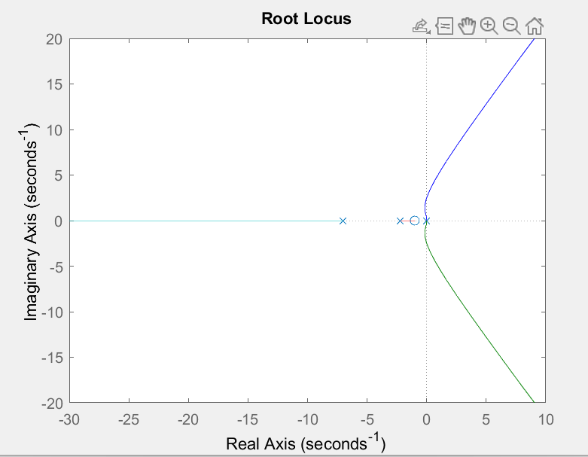
K = 2, z = 1

Slide 22
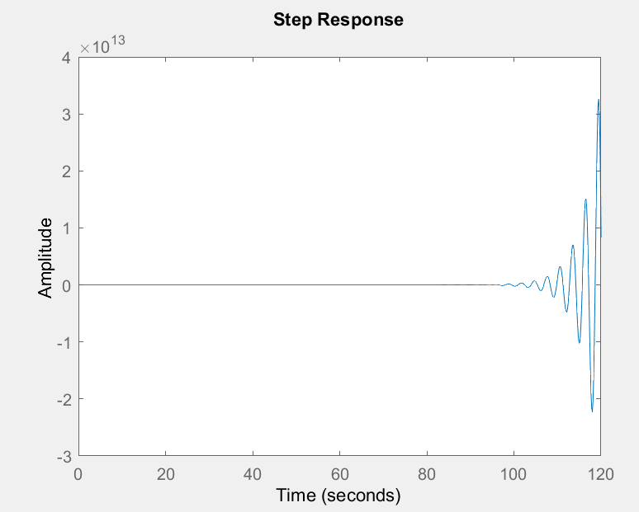
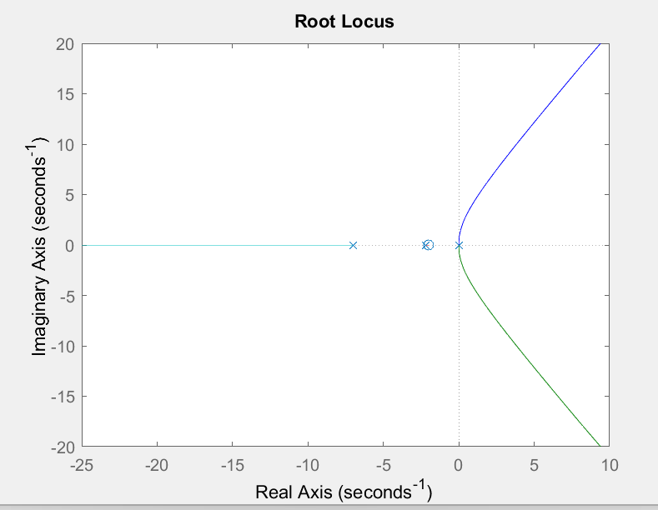
K = 1, z = 2
We observe from our experiments that the addition of a pole to our particular system ends up making it more unstable, rather than stable, limiting the value of K that can be chosen

Slide 23
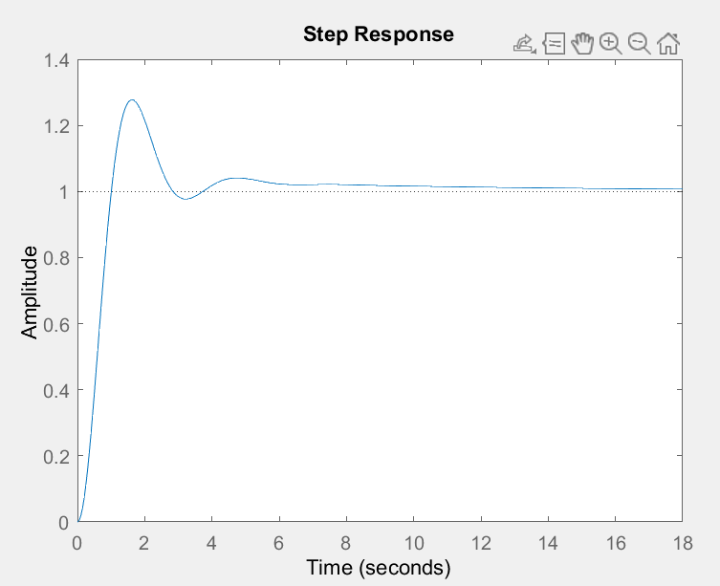


K1 = 1, K2 = 0.1, K3 = 0.1

Slide 24


Q6
Bode and Nyquist plots are used to obtain the stability of the system using the Open loop transfer function
From these plots we observe that our system is open loop stable

Slide 25
Q6
Bode and Nyquist plots are used to obtain the stability of the system using the Open loop transfer function
From these plots we observe that our system is open loop stable

Slide 26





Lag compensator
Alpha = 2, Tau = 1

Slide 27





Alpha = 3, Tau = 2

Slide 28





Alpha = 4, Tau = 7

Slide 29





Alpha = 1, Tau = 7

Slide 30





Alpha = 9, Tau = 5 5
From these experiments we observe that the value of Tau must be large and Alpha be small for the best response(lowest rise time)

Slide 31





Lead Compensator
Alpha = 2, Tau = 1

Slide 32





Alpha = 3, Tau = 2

Slide 33





Alpha = 4, Tau = 7

Slide 34
Alpha = 1, Tau = 7

Slide 35
Alpha = 9, Tau = 5 5
From these experiments we observe that the value of Tau must be large and Alpha be small for the best response(lowest rise time)

Slide 36
Thank You ☺

